Slide 1
MS10
Liver as a Model System for Mechanics, Flow, and Multiscale Mathematical Biology
James A. Glazier
Jessica L. Sparks
Paul Macklin
Hermann B. Frieboes
Shannon M. Mumenthaler
Indiana University
Miami University (Ohio)
Indiana University
University of Louisville
University of Southern California
July 17, 2017

Slide 2
Schedule
3:00-3:20 | Macklin | Primer: Liver microanatomy and biology for modelers
3:20-3:40 | Glazier | Sensitivity analysis of toxicity of acetaminophen in a multiscale liver sinusoid simulation
3:40-4:00 | Sparks | Biomechanical modeling of tissue perfusion in decellularized and native liver
4:00-4:20 | Macklin | Agent-based simulation of colon cancer metastases in large liver tissues
4:20-4:40 | Frieboes | Modeling and calibration of cancer drug response
4:40-5:00 | Mumenthaler | High-throughput image-based experiments to drive cancer model development
5:00-5:30 | All | Discussion

Slide 3
Agent-based simulation of colon cancer metastases in large liver tissues
July 17, 2017

Slide 4
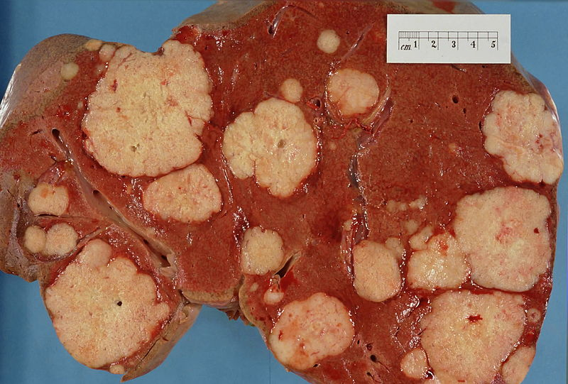
Scientific Motivation
Colon, breast, and many other carcinomas metastasize to the liver.
Micrometastases grow and eventually replace the original liver tissue
A few open questions:
1) What happens to the original tissue?
Degradation at the interface?
Displacement?
What triggers cell death?
Interaction with flow and transport?
2) Which liver properties most influence success or failure of metastasis?
ECM stiffness?
Flow properties?
3) Can the liver be modified to prevent, impede, or reverse metastasis?
Source: librepathology.org

Slide 5
What processes are needed to study this?
To model tumor cells:
Proliferation and death characteristics
Size
Motility
Mechanics
Hypotheses: how phenotype varies with microenvironment
To describe the liver parenchyma:
Flow and biotransport
Liver geometry
Mechanics
Hypotheses: flow disruption and death

Slide 6
Computational tools

Slide 7
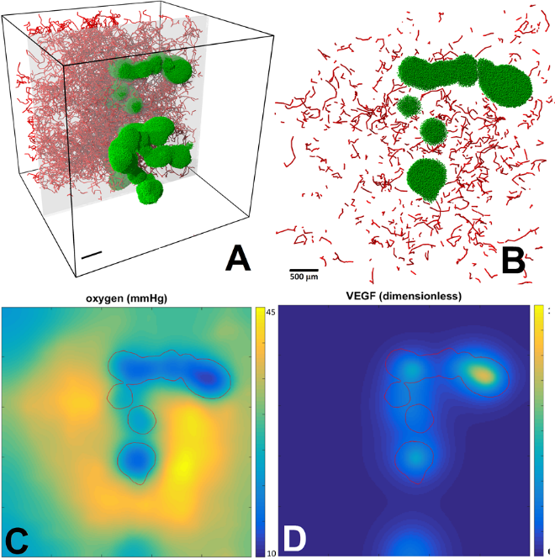
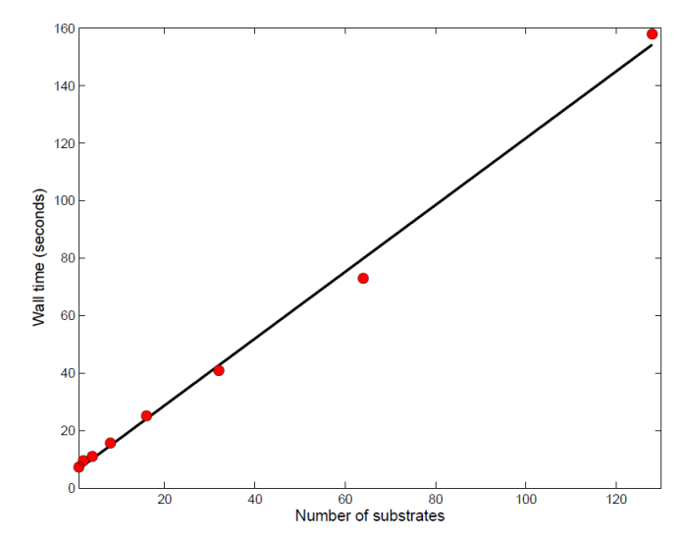
BioFVM: Simulating 3-D Biotransport
Design goal: Simulate multiple diffusing substrates in 3-D with desktop workstations
Typical use: pO₂, glucose, metabolic waste, signaling factors, and a drug, on 10 mm³ at 20 µm resolution
Features:
Cell-based sources/sinks
2nd-order accurate (space), 1st-order accurate (time), numerically stable
Method:
Operator splitting, LOD, customized Thomas solvers, etc.
Standard C++11, cross-platform
OpenMP parallelization
O(n) cost scaling in # substrates, # voxels
Simulating 5-10 substrates on 106 voxels
Reference: Ghaffarizadeh et al., Bioinformatics (2016)
Simulation time
1,000,000 voxels
Δx = 10 μm
Δt = 0.01 min
Simulate 2 minutes
# of substrates

Slide 8
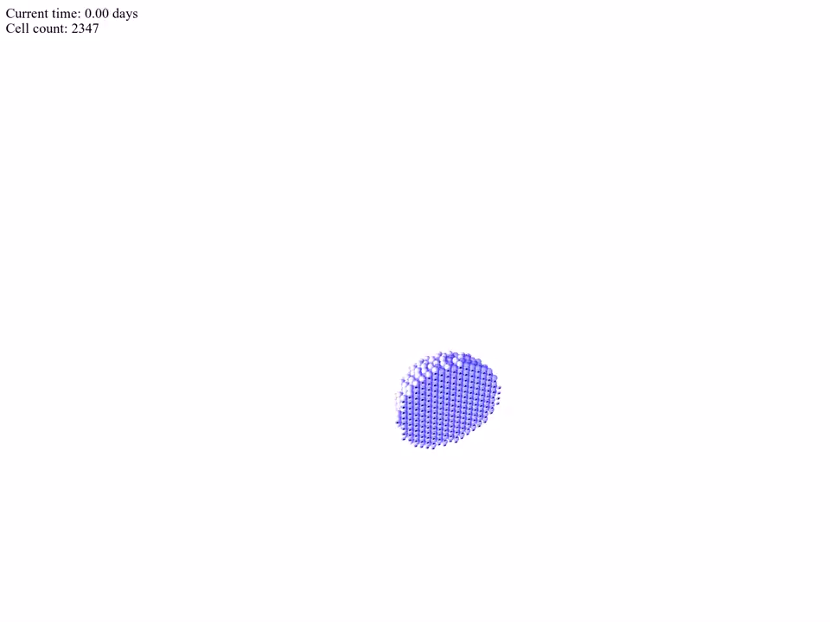
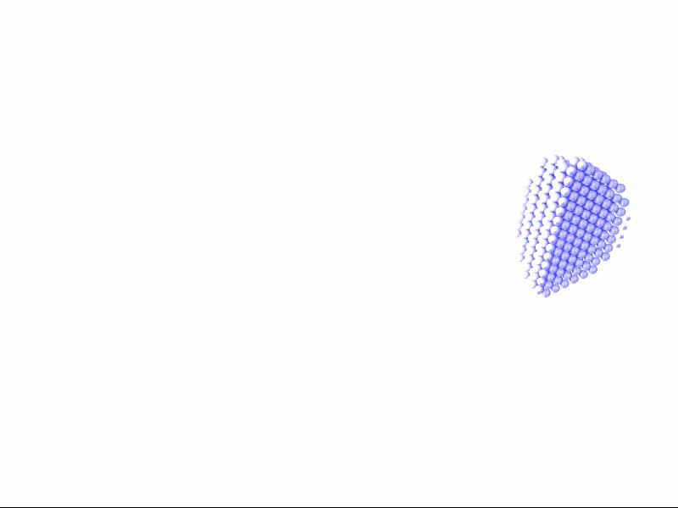
PhysiCell: A Multicellular Simulator
Design goal: Simulate 10⁶ or more cells in 3D with desktop workstations
Features:
Off-lattice cell positions
Mechanics-based cell movement
Fluid & solid sub-volumes
Microenvironment-dependent phenotype
Cell cycling, apoptosis, necrosis
Can dynamically attach custom functions on a cell-by-cell basis
Method:
Standard C++11, cross-platform
OpenMP parallelization
O(n) cost scaling
Reference: Ghaffarizadeh et al., PLoS Comput. Biol. (2017, in revision)

Slide 9
Model development

Slide 10
A reverse multiscale approach
A very typical multi-model approach:
Use a detailed discrete model to investigate up to a maximum feasible size.
Use a continuum model to efficiently simulate larger sizes.
Use observations, coarse-graining, model matching … to:
Inform continuum model development & constitutive relations
Calibrate parameters
We’re going to use the opposite!
Use a detailed continuum model to study flow in blocked lobules.
Use a discrete model to simulate larger sizes with small-scale effects.
Use observations from continuum model to:
Inform discrete model development & constitutive relations
Calibrate parameters

Slide 11
Model: parenchyma

Slide 12
Overall approach
Model the parenchyma as a collection of agents
Each agent is a mix of hepatocytes, endothelial cells, and fluid
We won’t have cell-resolution liver data, so we won’t model it.
Also more compatible with Darcy flow approach of Sparks.
Model impact of fluid flow on biotransport
Model tumor-parenchyma mechanics
Model mechanical disruption of the parenchyma
Flow disruption
Tissue death

Slide 13
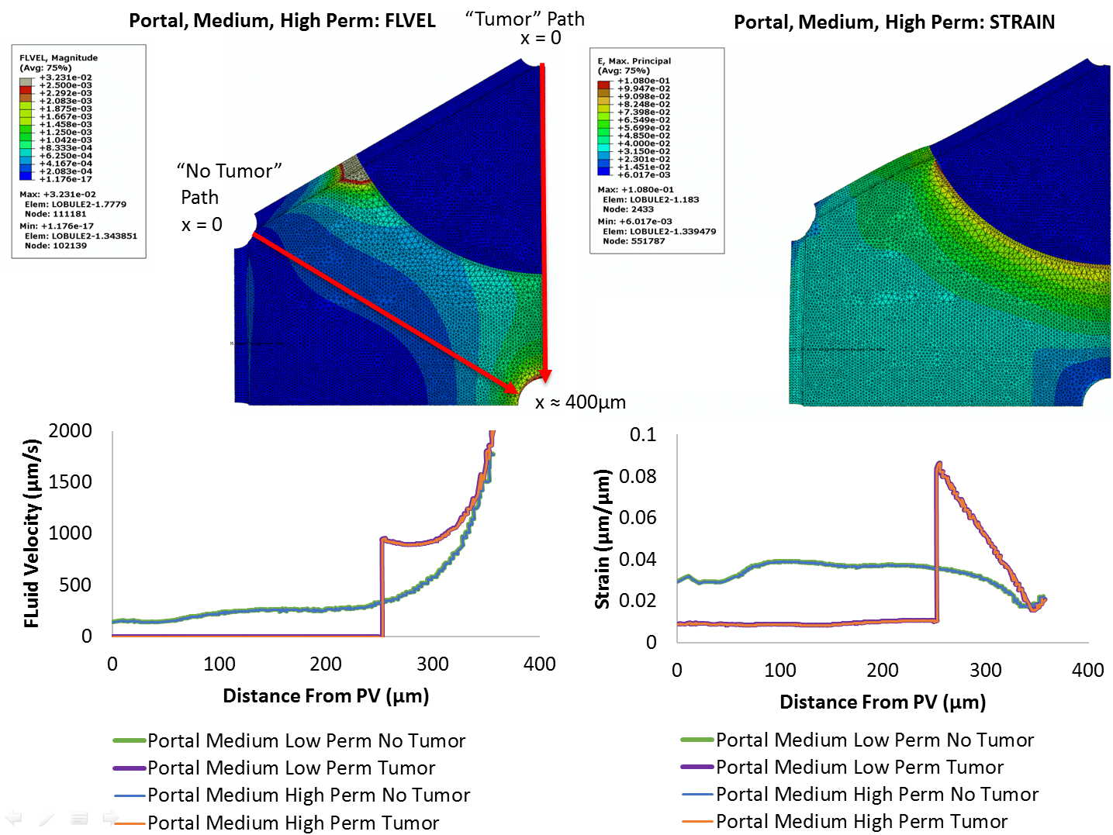
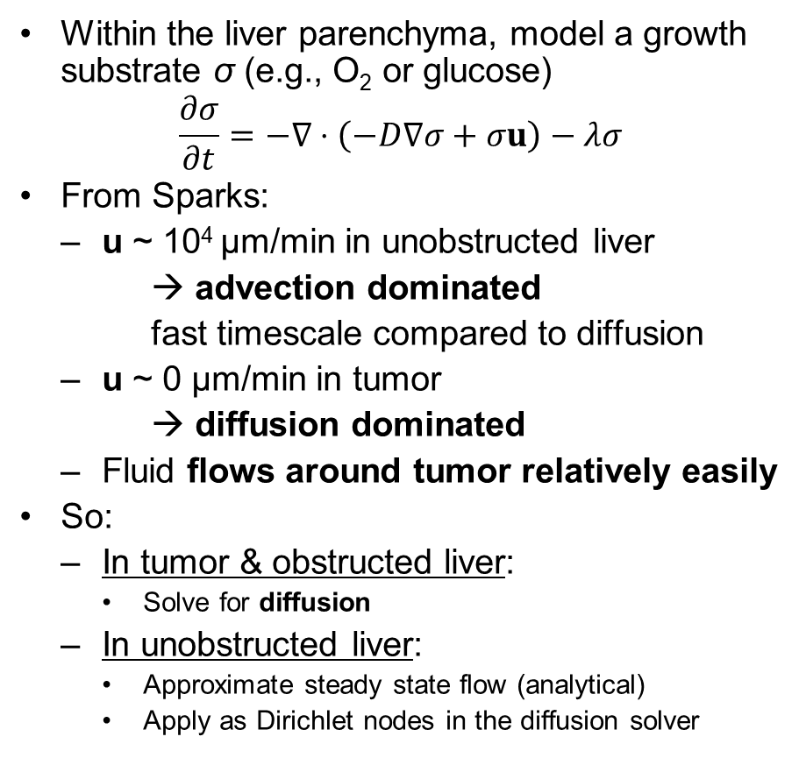
Fluid flow and biotransport
Within the liver parenchyma, model a growth substrate σ (e.g., O₂ or glucose)
$$\frac{∂σ}{∂t}=−∇⋅\left(−D∇σ+σu\right)−λσ$$
From Sparks:
u ~ 10⁴ µm/min in unobstructed liver
→ advection dominated
fast timescale compared to diffusion
u ~ 0 µm/min in tumor
→ diffusion dominated
Fluid flows around tumor relatively easily
So:
In tumor & obstructed liver:
Solve for diffusion
In unobstructed liver:
Approximate steady state flow (analytical)
Apply as Dirichlet nodes in the diffusion solver

Slide 14
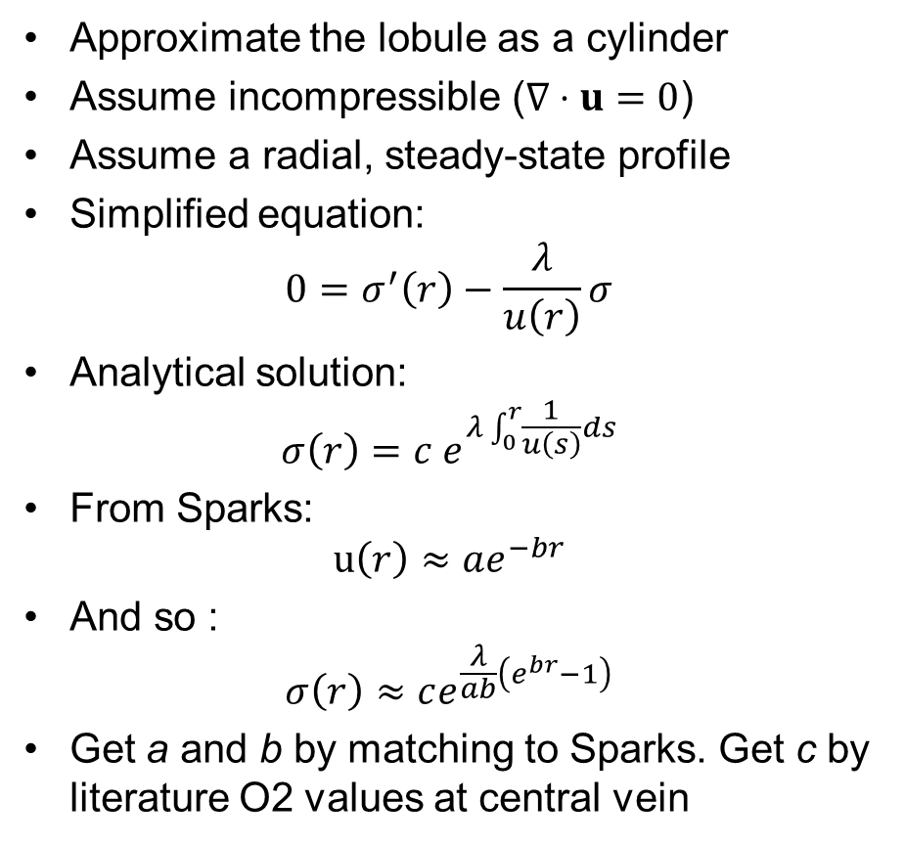
Radial approximation in lobules
Approximate the lobule as a cylinder
Assume incompressible ($∇⋅u=0$)
Assume a radial, steady-state profile
Simplified equation:
$$0=σ^{′}\left(r\right)−\frac{λ}{u\left(r\right)}σ$$
Analytical solution:
$$σ\left(r\right)=c e^{λ\int_{0}^{r}{\frac{1}{u\left(s\right)}ds}}$$
From Sparks:
$$u\left(r\right)≈ae^{−br}$$
And so :
$$σ\left(r\right)≈ce^{\frac{λ}{ab}\left(e^{br}−1\right)}$$
Get a and b by matching to Sparks. Get c by literature O2 values at central vein

Slide 15
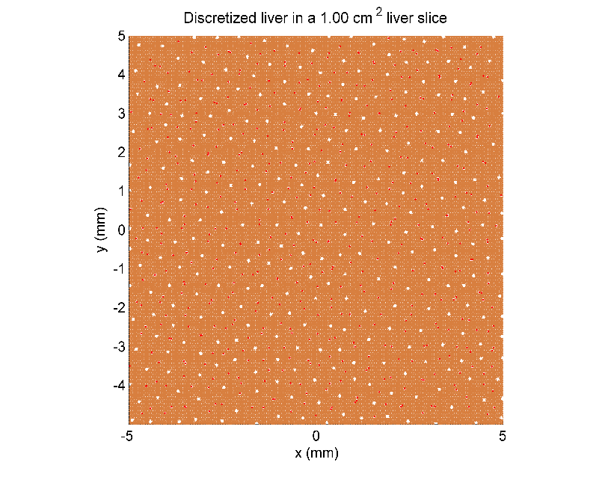
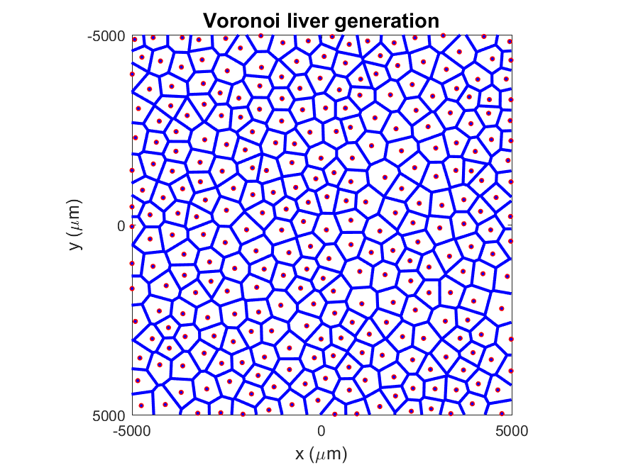
Creating a digital liver geometry …
Set number of lobules per mm²
Seed central veins randomly to meet the target density
Merge small lobules and split large lobules
Generate a Voronoi tessellation to estimate lobule boundaries
Place portal triads at the vertices
Fill the remaining space with 60 µm parenchyma agents

Slide 16
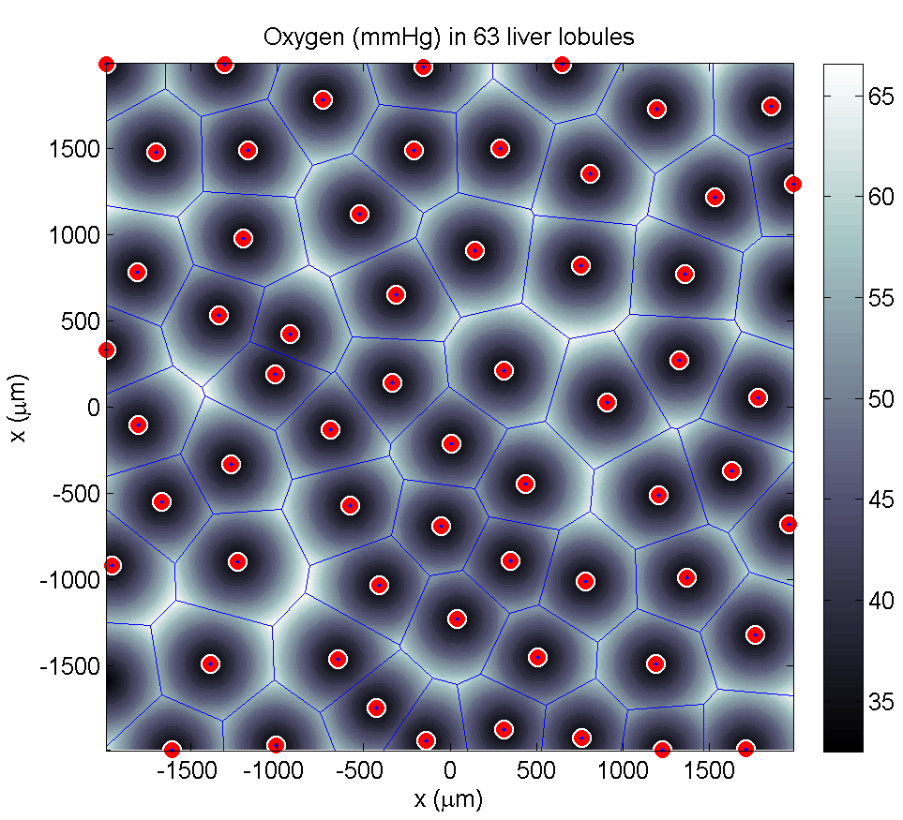
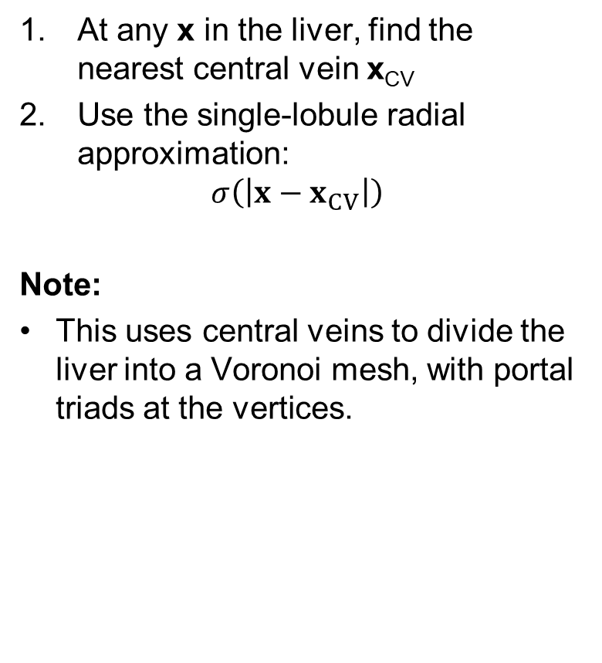
Approximation in larger liver tissues
At any x in the liver, find the nearest central vein x_{CV}
Use the single-lobule radial approximation:
$$σ\left(\left|x−x_{CV}\right|\right)$$
Note:
This uses central veins to divide the liver into a Voronoi mesh, with portal triads at the vertices.

Slide 17
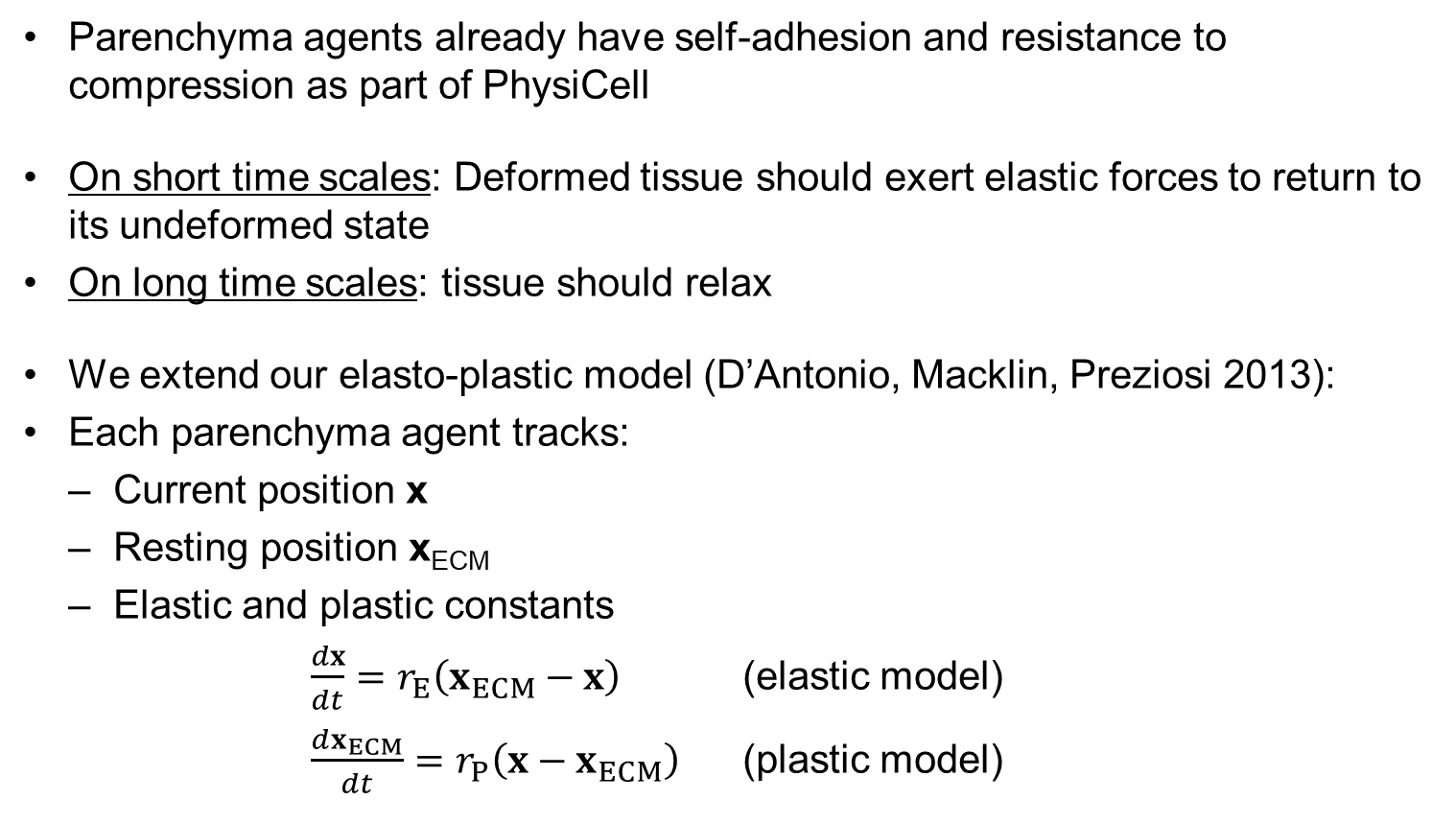
Parenchyma ECM mechanics
Parenchyma agents already have self-adhesion and resistance to compression as part of PhysiCell
On short time scales: Deformed tissue should exert elastic forces to return to its undeformed state
On long time scales: tissue should relax
We extend our elasto-plastic model (D’Antonio, Macklin, Preziosi 2013):
Each parenchyma agent tracks:
Current position x
Resting position x_{ECM}
Elastic and plastic constants
$\frac{dx}{dt}=r_{E}\left(x_{ECM}−x\right)$ (elastic model)
$\frac{dx_{ECM}}{dt}=r_{P}\left(x−x_{ECM}\right)$ (plastic model)

Slide 18
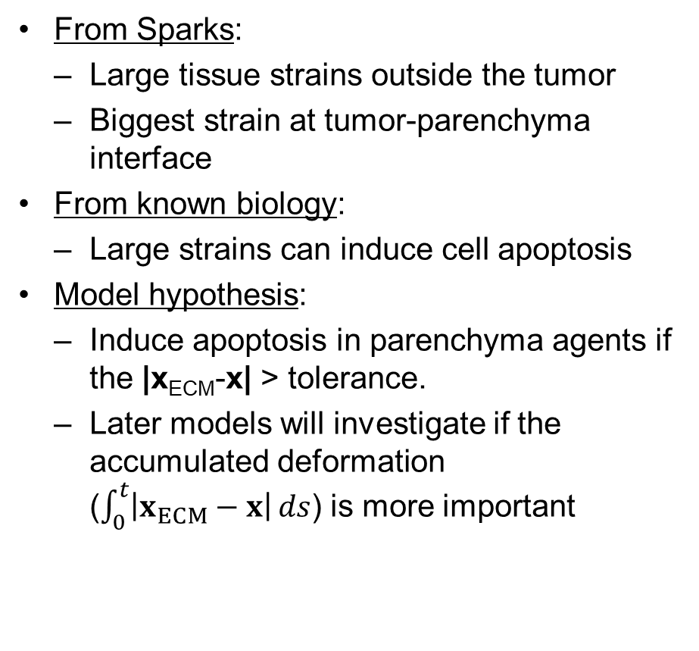
Parenchyma death hypothesis
From Sparks:
Large tissue strains outside the tumor
Biggest strain at tumor-parenchyma interface
From known biology:
Large strains can induce cell apoptosis
Model hypothesis:
Induce apoptosis in parenchyma agents if the |x_{ECM}-x| > tolerance.
Later models will investigate if the accumulated deformation ($\int_{0}^{t}{\left|x_{ECM}−x\right|}ds$) is more important

Slide 19
Hypotheses for flow disruption
For now, use the easiest ones:
Flow is disrupted (remove Dirichlet node) where:
Parenchyma agents apoptosing or apoptosed, OR
Tumor cells are present.

Slide 20
Model: Tumor cells

Slide 21
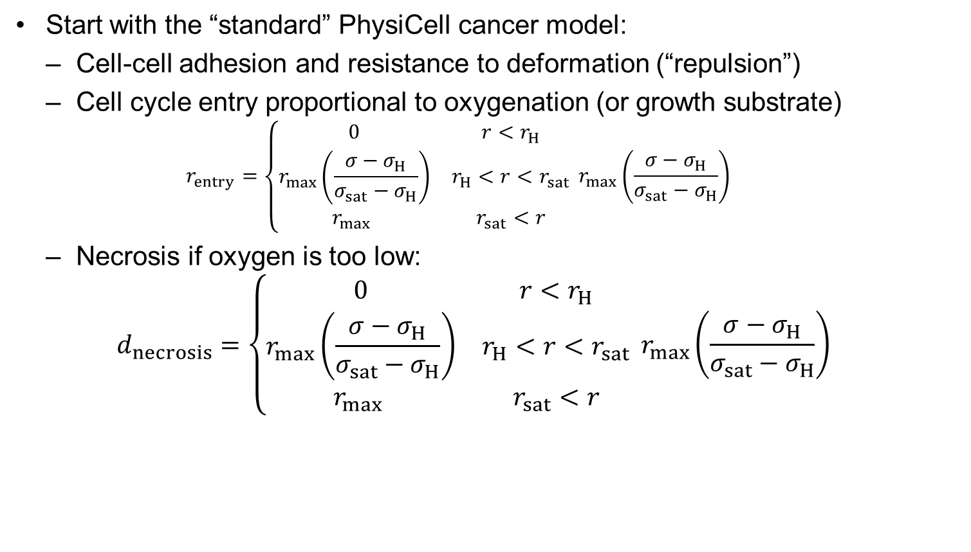
Simple model:
Start with the “standard” PhysiCell cancer model:
Cell-cell adhesion and resistance to deformation (“repulsion”)
Cell cycle entry proportional to oxygenation (or growth substrate)
$$r_{entry}=\left\{\begin{matrix}0 & r<r_{H} \\ r_{max}\left(\frac{σ−σ_{H}}{σ_{sat}−σ_{H}}\right) & r_{H}<r<r_{sat} \\ r_{max} & r_{sat}<r\end{matrix}\right. r_{max}\left(\frac{σ−σ_{H}}{σ_{sat}−σ_{H}}\right)$$
Necrosis if oxygen is too low:
$$d_{necrosis}=\left\{\begin{matrix}0 & r<r_{H} \\ r_{max}\left(\frac{σ−σ_{H}}{σ_{sat}−σ_{H}}\right) & r_{H}<r<r_{sat} \\ r_{max} & r_{sat}<r\end{matrix}\right. r_{max}\left(\frac{σ−σ_{H}}{σ_{sat}−σ_{H}}\right)$$

Slide 22
Results

Slide 23
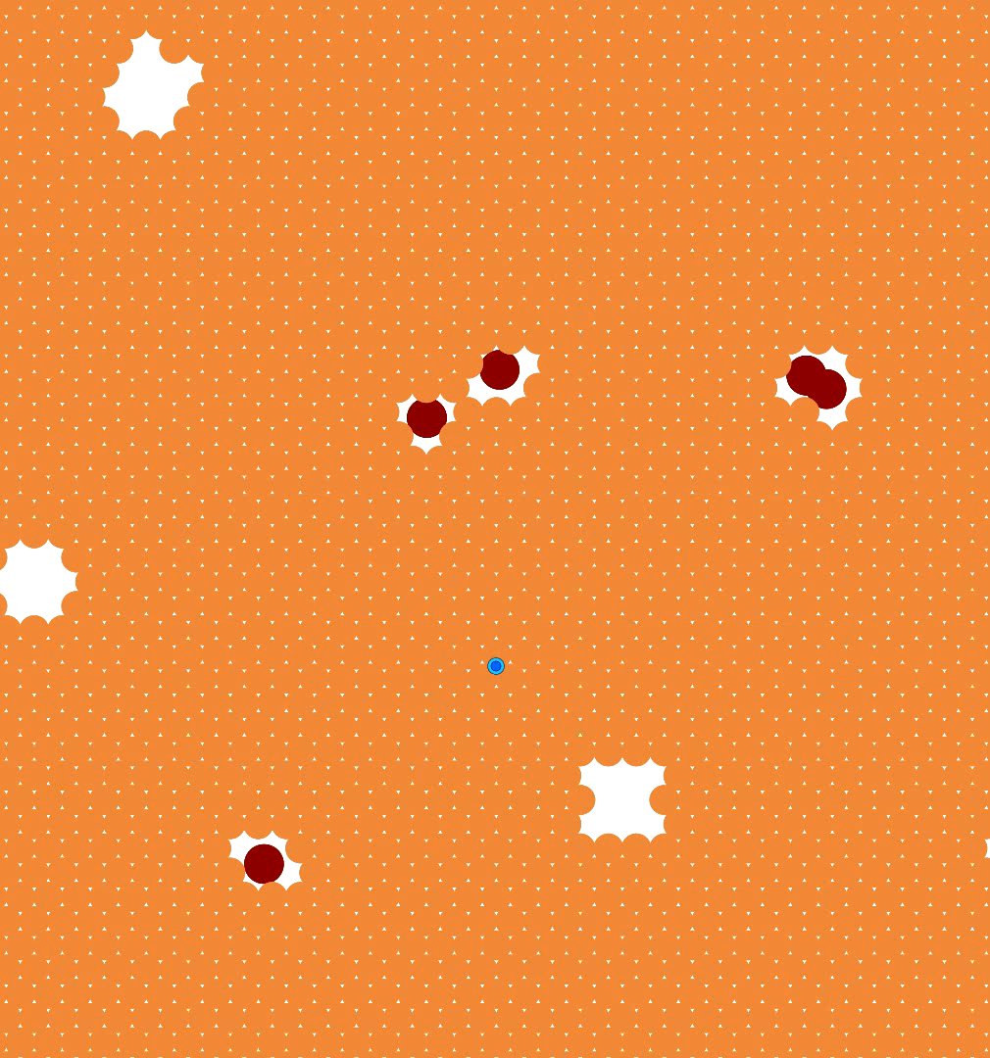
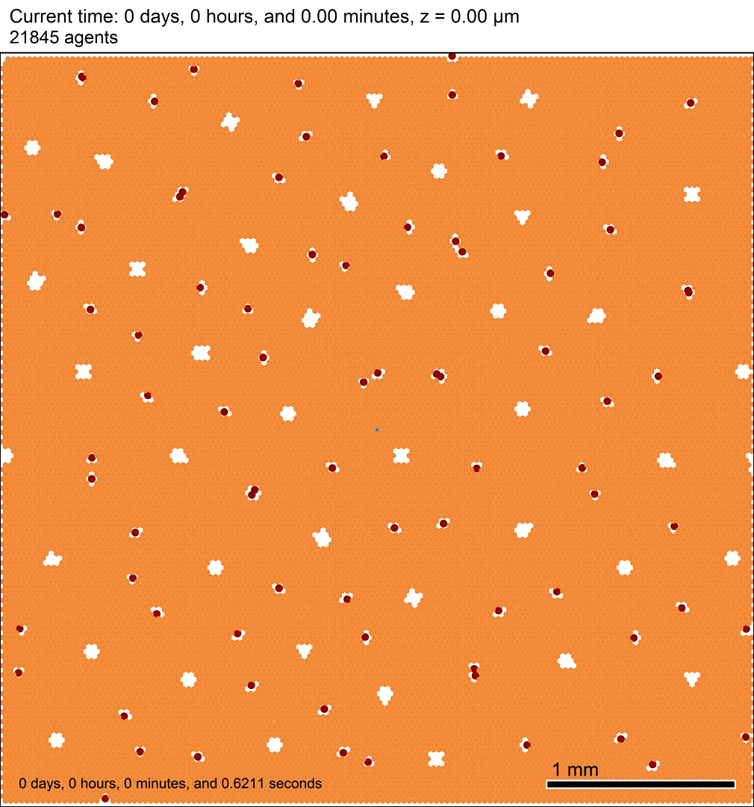
A small simulation
Seed a single cancer cell:
Blue: Ki67- (quiescent)
Green: Ki67+ (entered cycle)
Magenta: Ki67+ (after mitosis)
Add 4 mm x 4 mm of liver:
Red: portal triads
White spaces: central veins
Orange: parenchyma agents
Shades of fuchsia: tissue deformation (displacement)
Black: apoptotic parenchyma
Simulate growth, with random seeding allowed

Slide 24
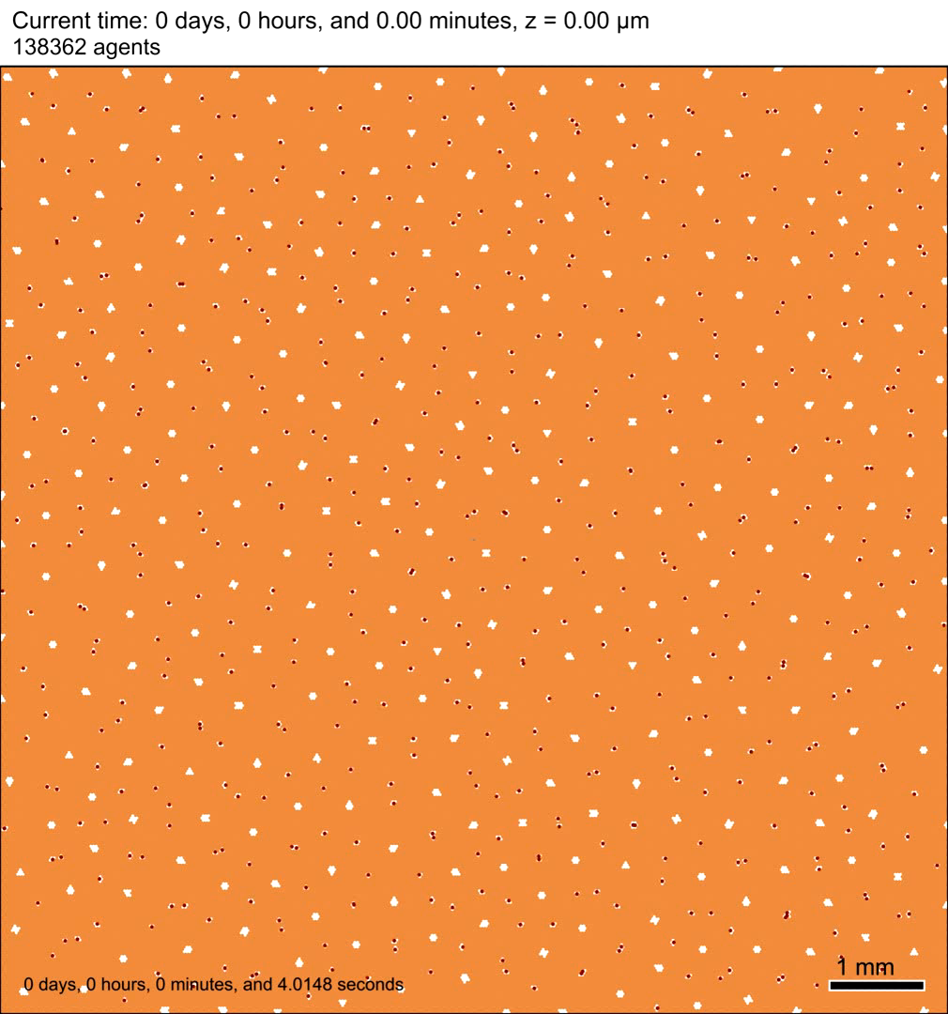
1 cm² liver! (~300 lobules)

Slide 25
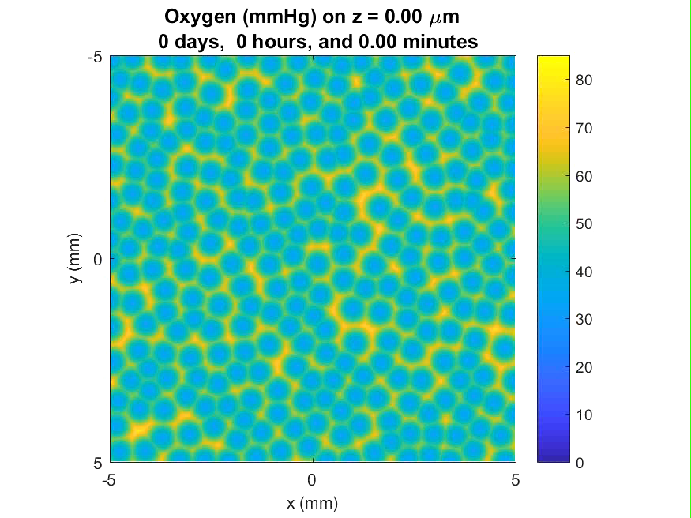
A 1 cm² liver! (~300 lobules)

Slide 26


Higher seeding rate in 1 cm²

Slide 27
Future steps
Calibrate tumor model to high-throughput data. (See Shannon’s talk!)
Oxygen (in)dependence
Pressure-induced cycle arrest, necrosis
Motility?
PhysiCell refinements
Better tumor-parenchyma mechanical interactions
Reduced water intake for high cell pressure
Perform parameter space investigation. Compare to clinical morphologies.
Impact of soft, stiff tissues

Slide 28
Open Source
We are releasing all our simulation codes and tools as open source
We use BSD and MIT licenses:
Compliant with GPL v2 and v3 codes
Does not preclude commercialization
Students can use their codes post-graduation without ambiguity
Already released as open source:
BioFVM (Bioinformatics, 2016)
PhysiCell (PLoS Computational Biology, in revision)
CellPD (BMC Systems Biology, 2016)
Visit OpenSource.MathCancer.org

Slide 29

Thank you
Recent students and collaborators
Postdocs (USC)
Ahmadreza Ghaffarizadeh – lead on BioFVM, PhysiCell (now at Agilent)
Samuel Friedman – lead on MultiCellDS (now at Opto-Knowledge Systems)
Graduate students (USC)
Edwin Juarez Rosales – lead on parameter identification methods (now at UCSD)
Colleagues
Biology: Shannon Mumenthaler, Roy Lau, and Patrick Chiang (USC)
Medicine: David B. Agus (USC)
Modeling: Jessica L. Sparks (Miami U.), Hermann B. Frieboes (U. Louisville)
Funding
NIH Provocative Questions grant (1R01CA180149)
NIH PS-OC center grant (5U54CA143907)
Breast Cancer Research Foundation (PI: Agus/Macklin) (PI: Gilkes/Macklin) (PI: Ewald/Macklin)
Breast Cancer Research Foundation / Jayne Koskinas & Ted Giovanis (AMIGOS)
USC James H. Zumberge Research & Innovation Fund

